Slide 1
GHDP meeting july 6th

Slide 2
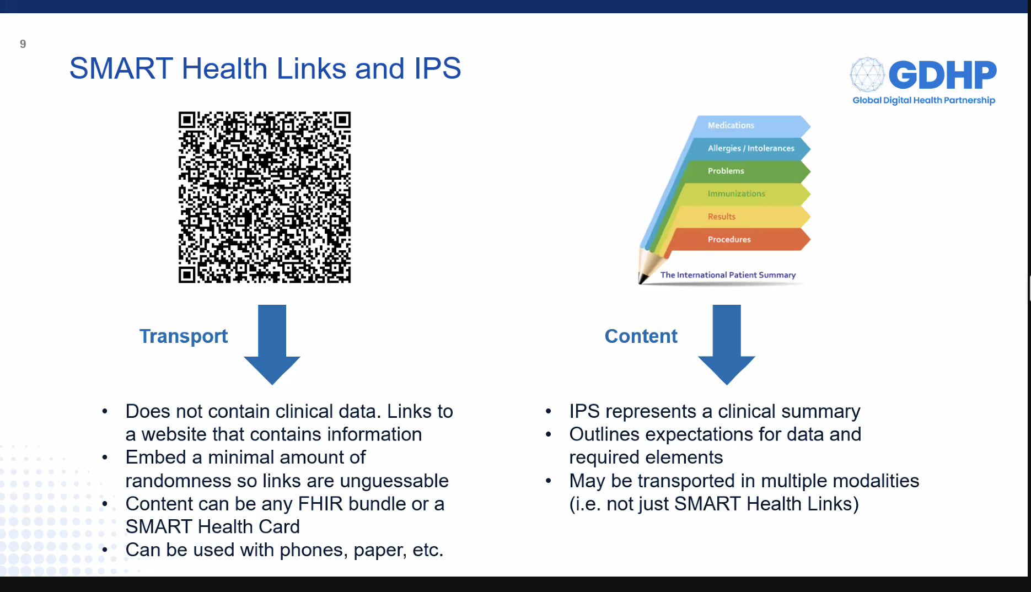

Slide 3
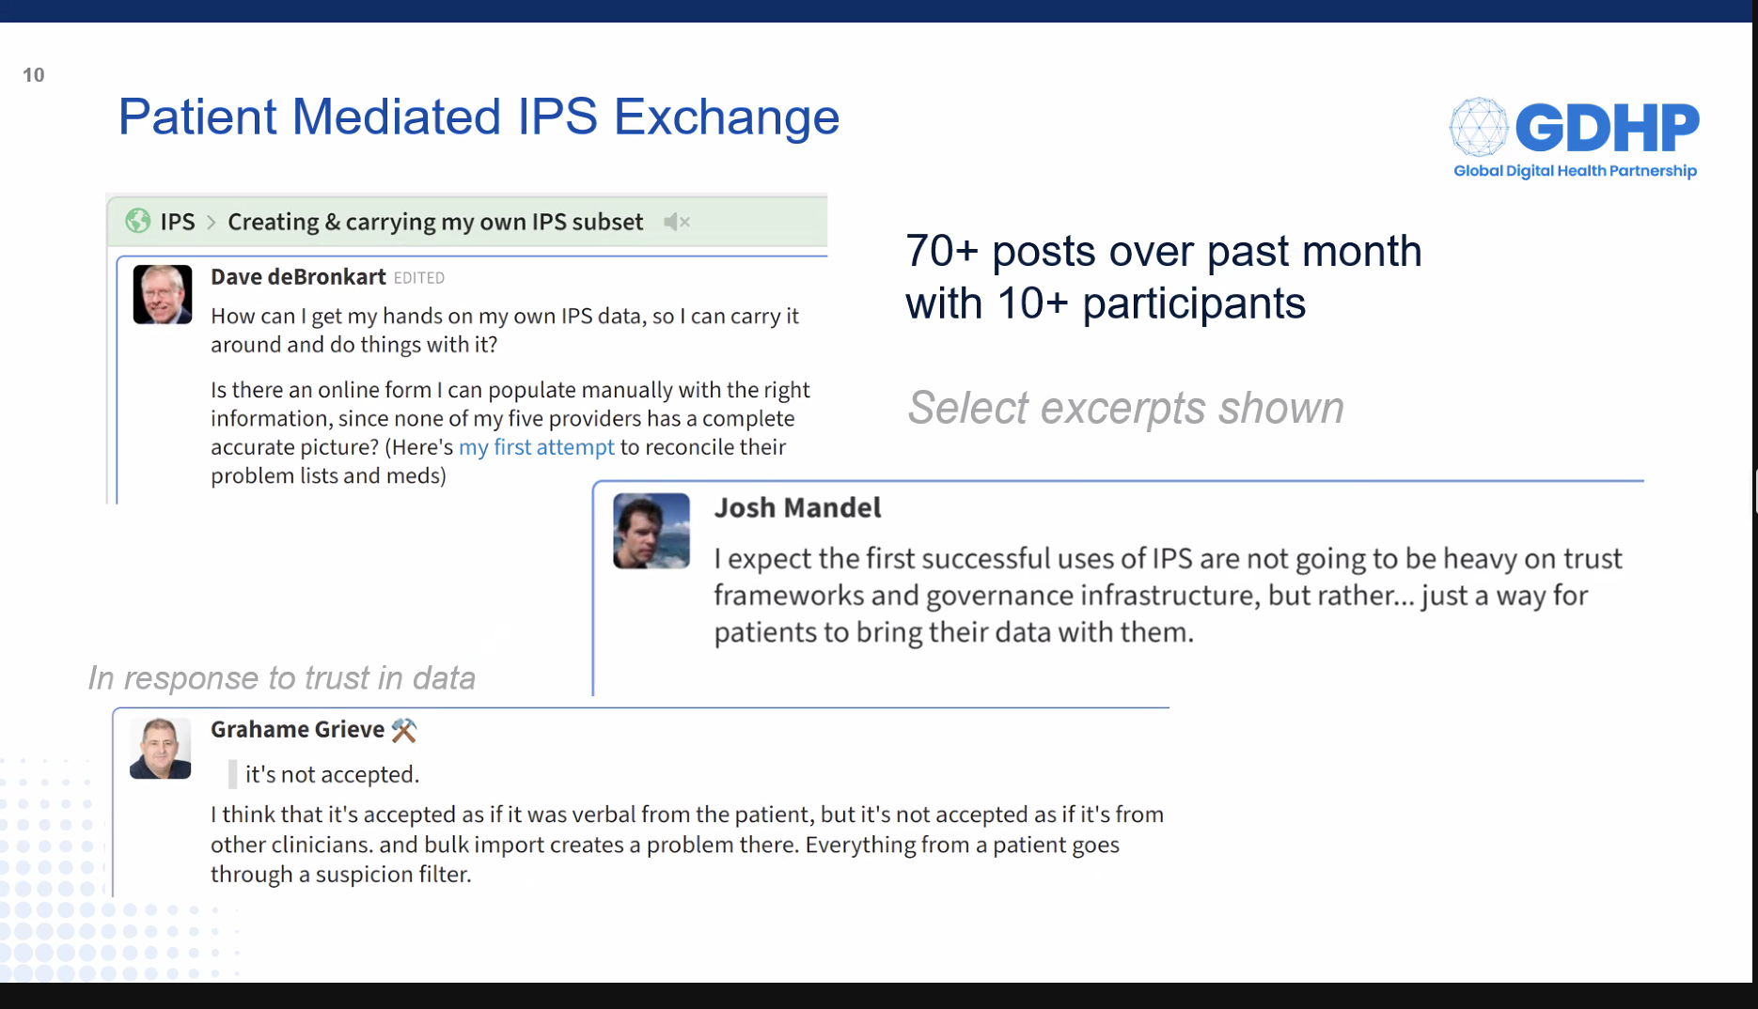

Slide 4
